Slide 1
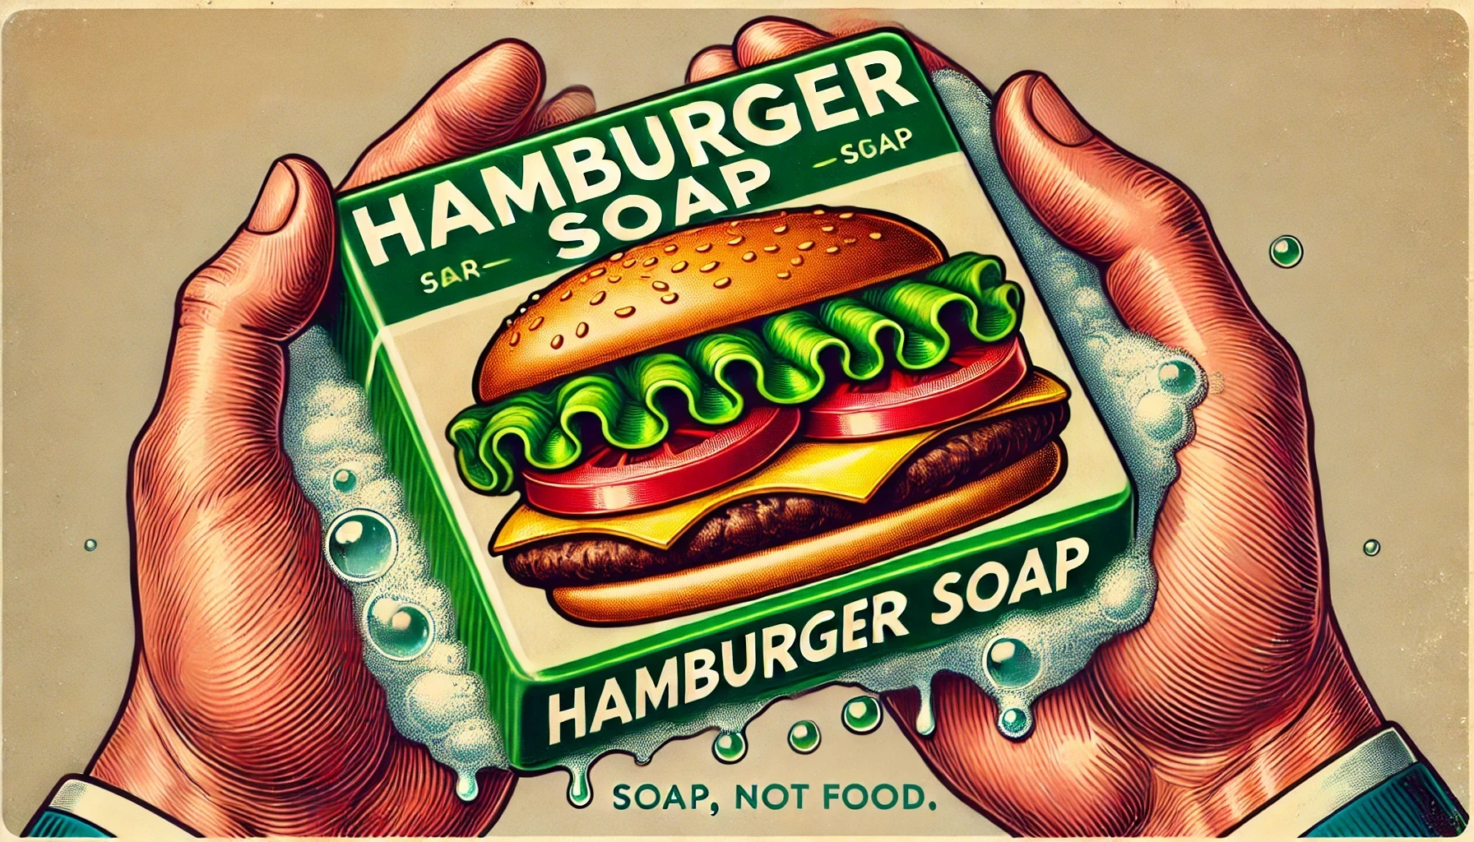

Slide 2
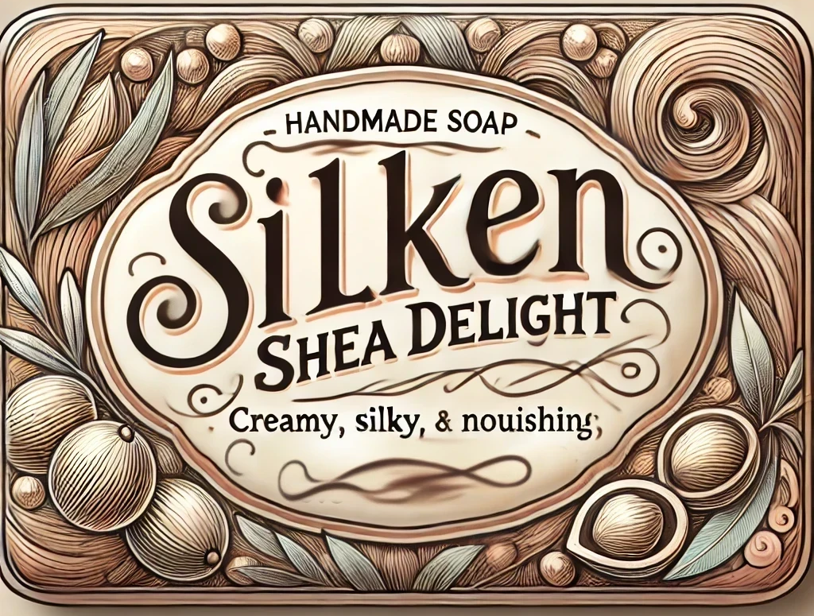

Slide 3
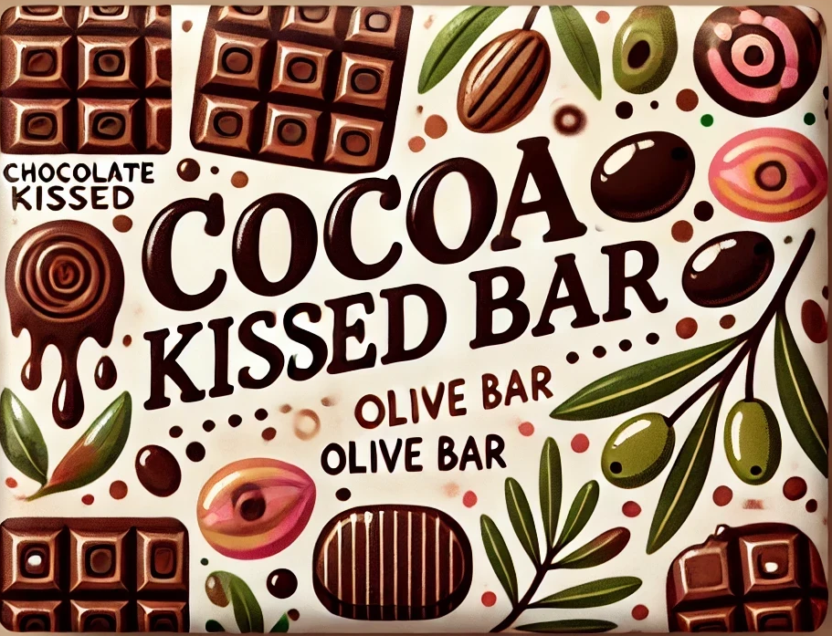

Slide 4
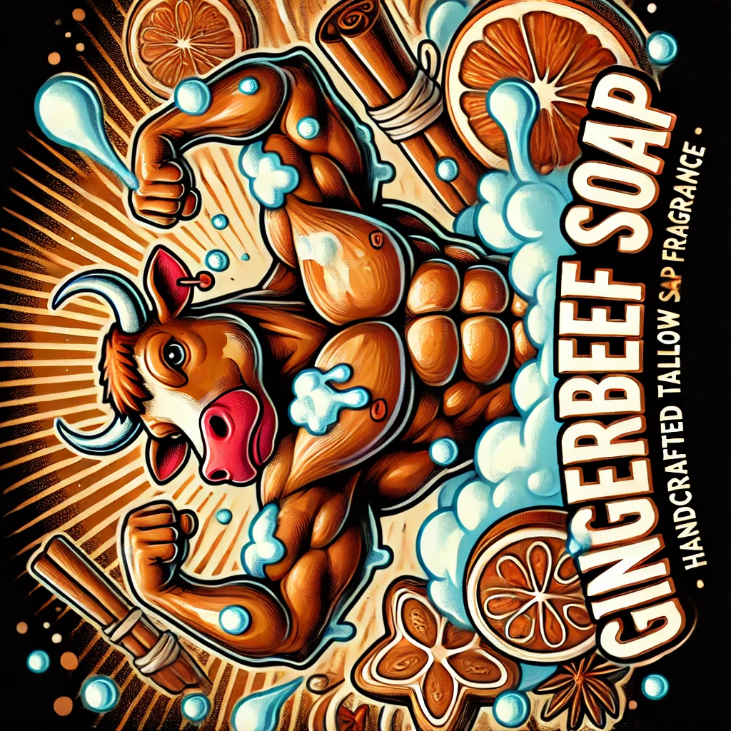
Gingerbeef Soap (4 bars, 2/8/25)
Water 152g
NaOH 54.19g
Oils 400g
Gingerbread Cookie fragrance 14g
Bentonite Clay 1tbs
Gingerbeef Soap (4 bars, 2/8/25)
Water 152g
NaOH 54.19g
Oils 400g
Gingerbread Cookie fragrance 14g
Bentonite Clay 1tbs

Slide 5


Gingerbeef Soap (4 bars, 2/8/25)
Water 152g
NaOH 54.19g
Oils 400g
Gingerbread Cookie fragrance 14g
Bentonite Clay 1tbs
Gingerbeef Soap (4 bars, 2/8/25)
Water 152g
NaOH 54.19g
Oils 400g
Gingerbread Cookie fragrance 14g
Bentonite Clay 1tbs

Slide 6
Gingerbeef Soap (5/1/25)
Tallow
Castor oil
NaOH
Fragrance
Gingerbeef Soap (5/1/25)
Tallow
Castor oil
NaOH
Fragrance

Slide 7

Rosemary Tallow Soap (2 bars, 2/8/25)
Water 76g
NaOH 27.095g
Beef Tallow 200g
Rosemary oil 7g
Rosemary Tallow Soap (2 bars, 2/8/25)
Water 76g
NaOH 27.095g
Beef Tallow 200g
Rosemary oil 7g

